Slide 1
INFORMATION ENCODING STANDARDS FINAL PROJECT ON ASP.NET Core web app with user data protected by authorization
TEAM MEMBERS
Milina Jasvin Corderio – 200593642
Divya Gandabhai Chaudhari – 200593020
Jesal Kamleshbhai Patel– 200594609

Slide 2
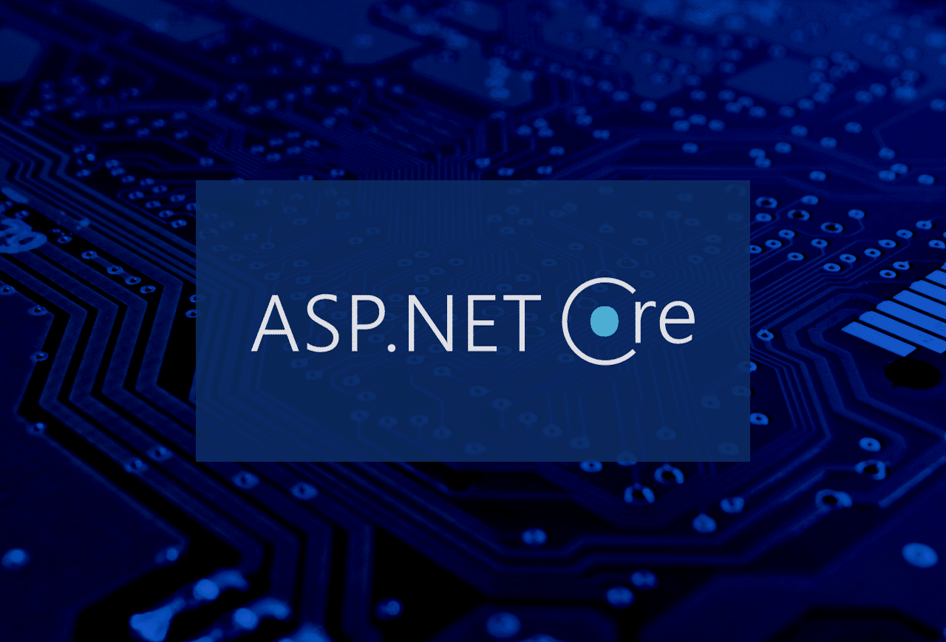
Overview of PROJECT
Introduction
Technologies & Tools used
Visual representation
Data management
conclusion

Slide 3
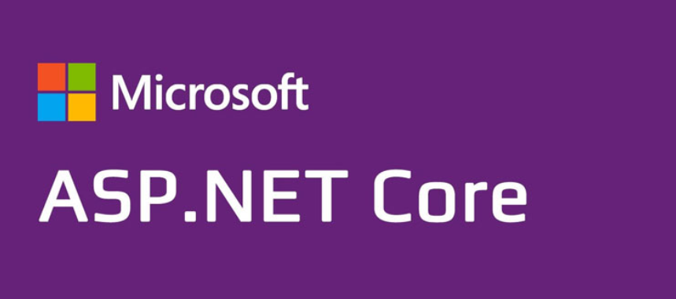
.
Introduction
ASP.NET Core provides a robust security framework for authorization and securing data.
The creation of an ASP.NET Core web application with user-authenticated access is described in this paper. Users have access to a list of their registered contacts after being placed into security groups. Each security group has the following permissions:
Registered users - Have the ability to read permitted data and edit or remove their personal data
Managers - Have the authority to accept or reject contact details only approved users can approve contacts
Administrators - Have the authority to approve, reject, edit or delete any content.

Slide 4
Technologies & Tools used
ASP.NET Framework: Visual Studio was used to create the website, utilizing its powerful.NET features for creating web apps.
C# programming language: It is used by the ASP.NET framework to manage backend activities and server-side scripting.
HTML & CSS - We used HTML & CSS for front-end development to create a user interface that is both visually appealing and responsive.
SQL Server Management Studio (SSMS): When creating and managing a SQL Server database, SSMS is utilized to guarantee data security and integrity.

Slide 5
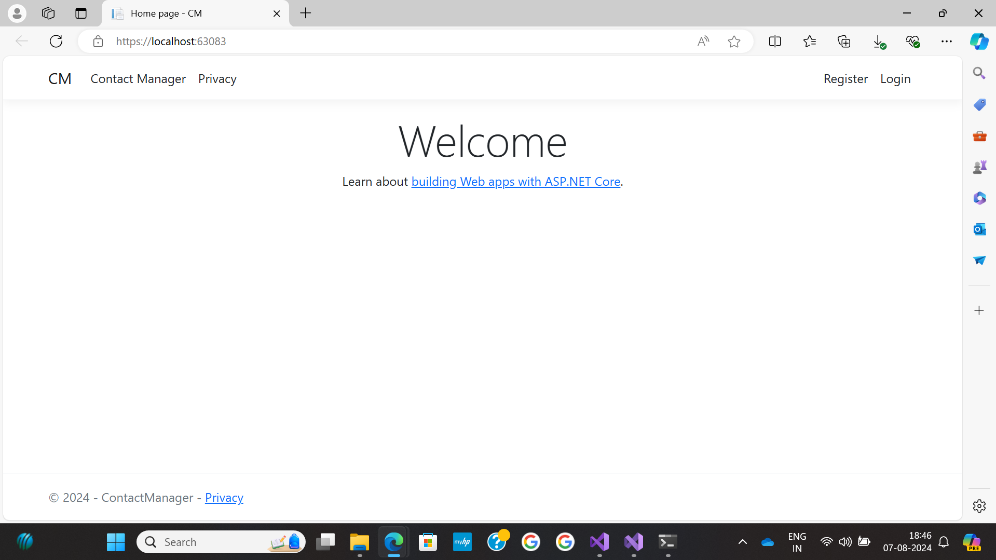
HOME PAGE OF CORE APP

Slide 6
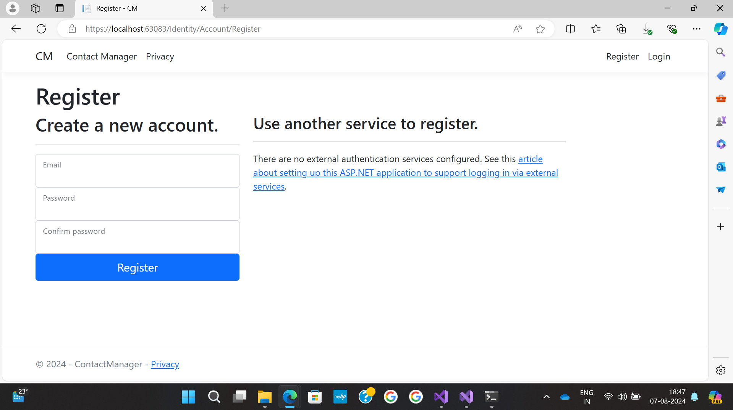
Register as New User

Slide 7
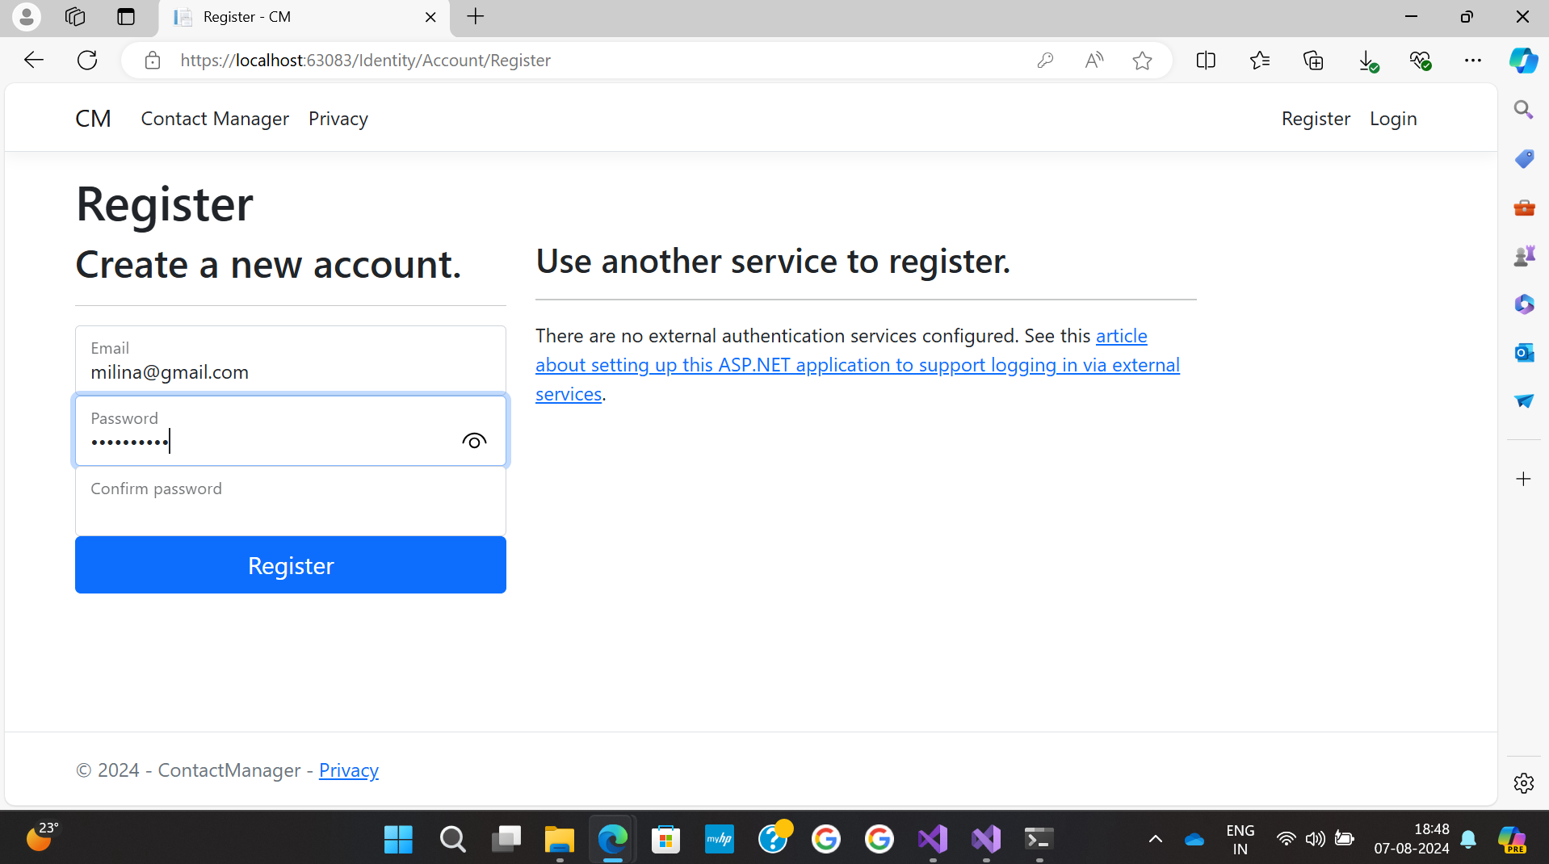
Login As New User

Slide 8
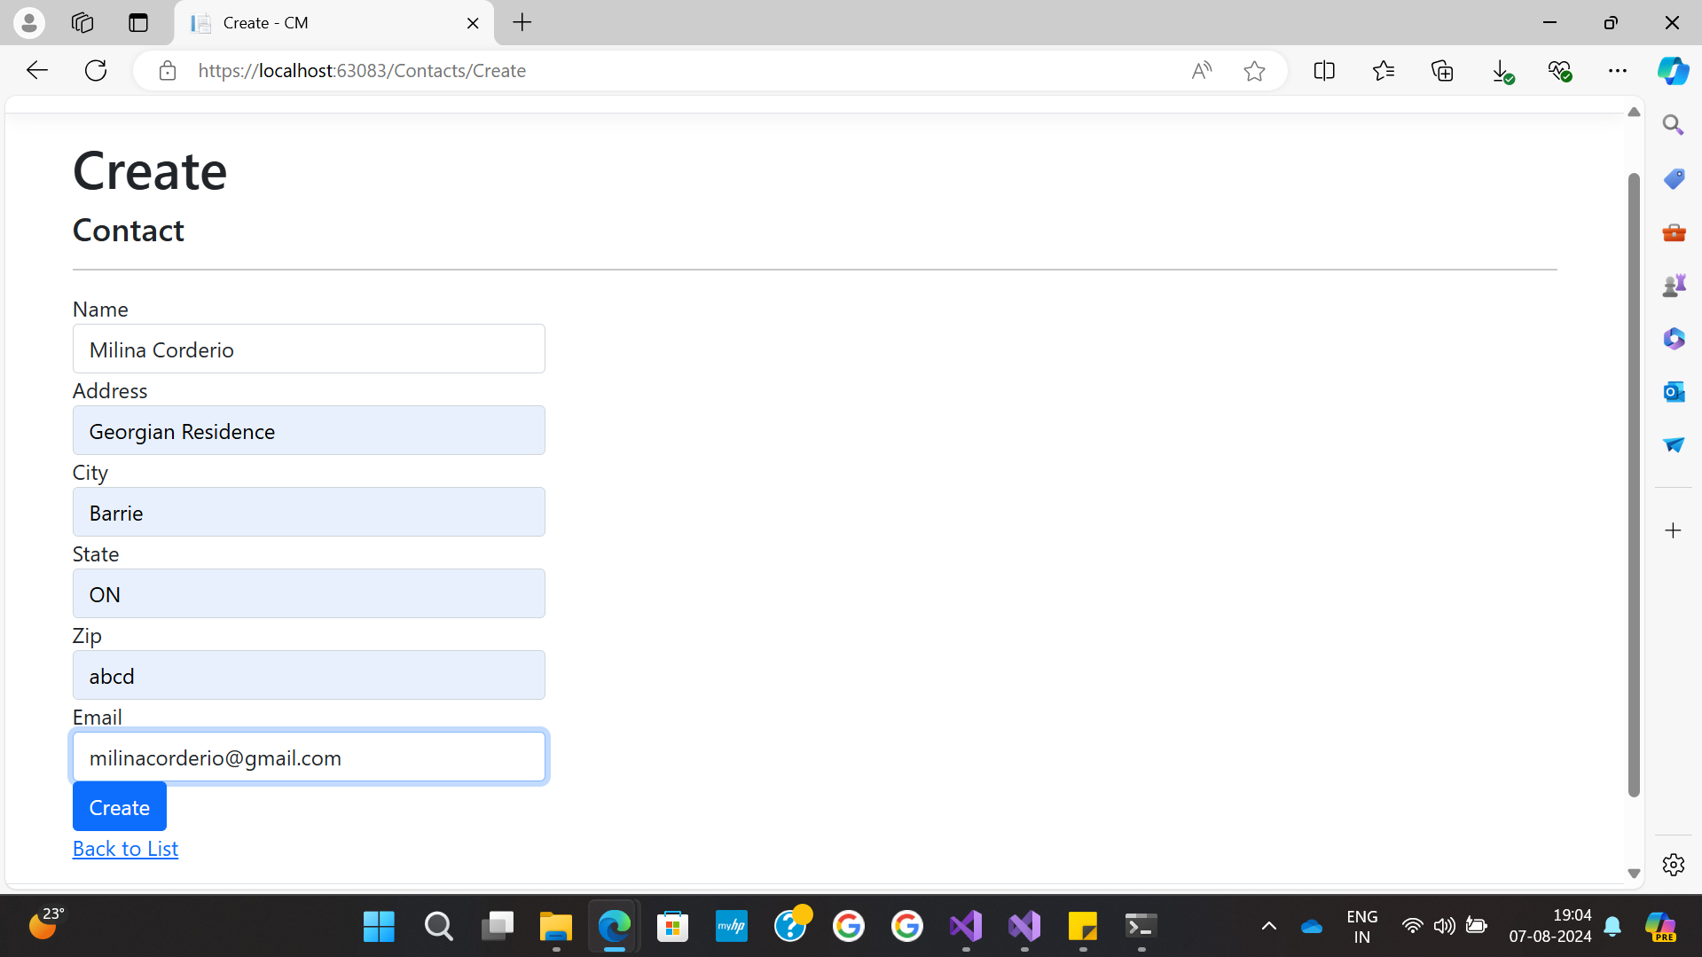
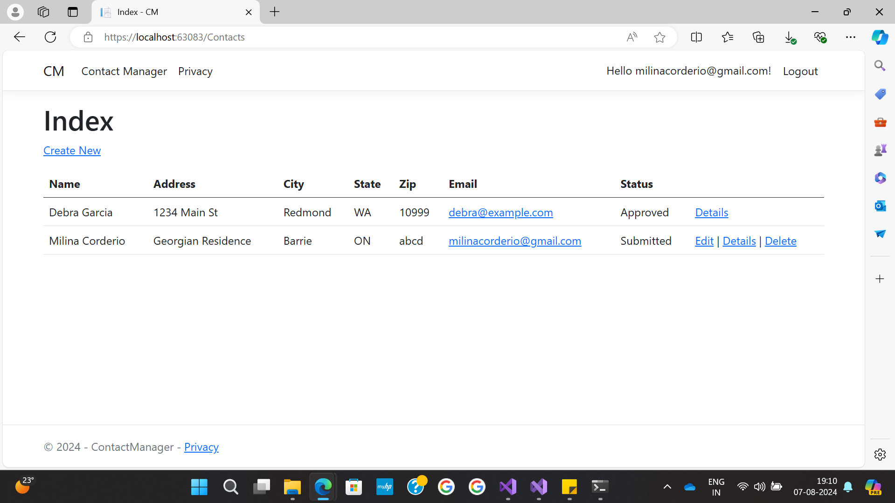
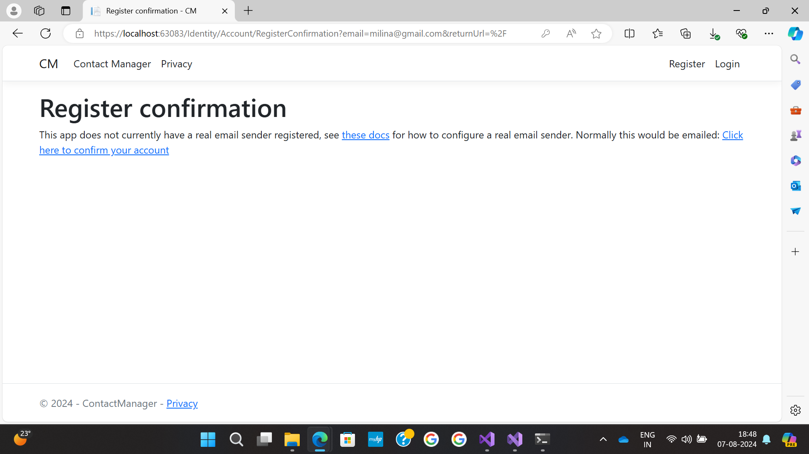
User Views

Slide 9
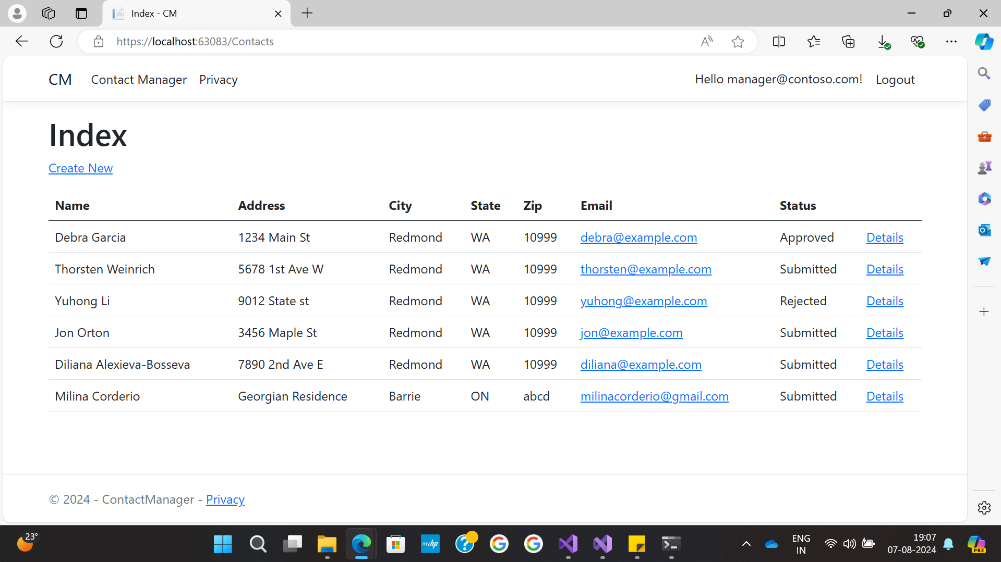
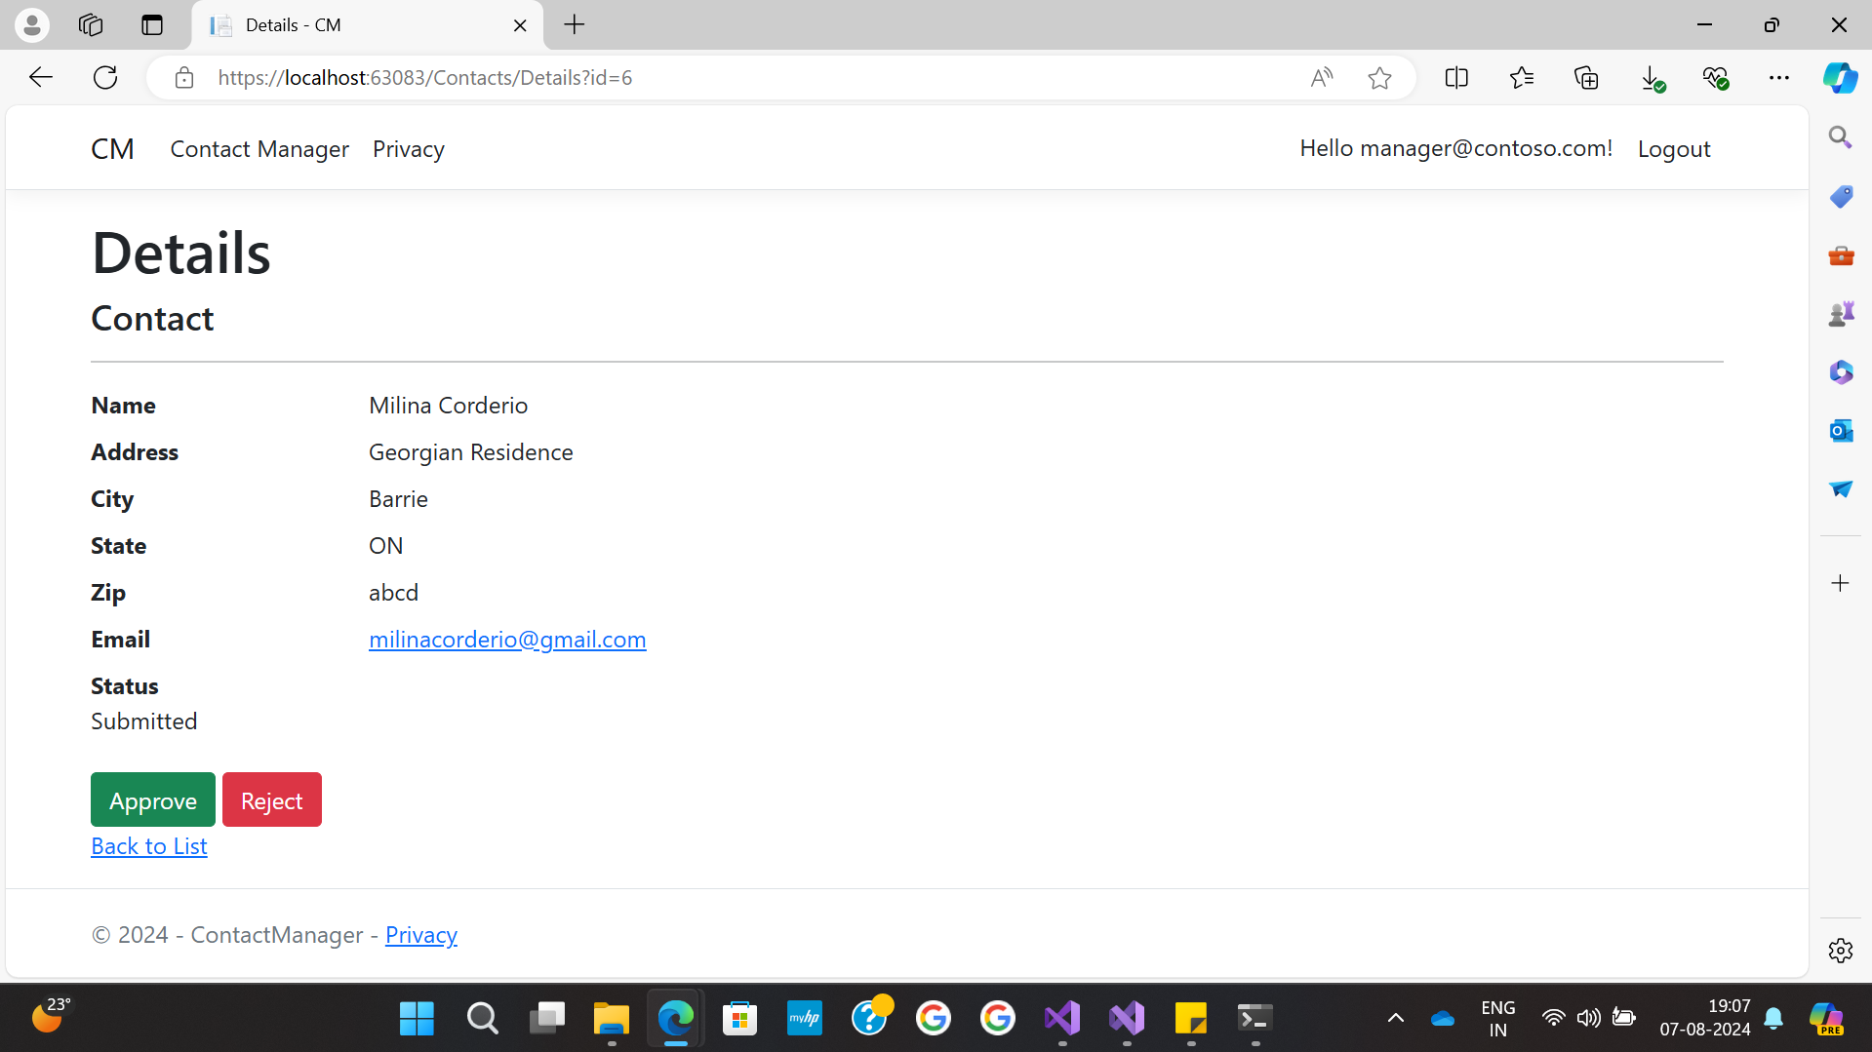
Manager View

Slide 10
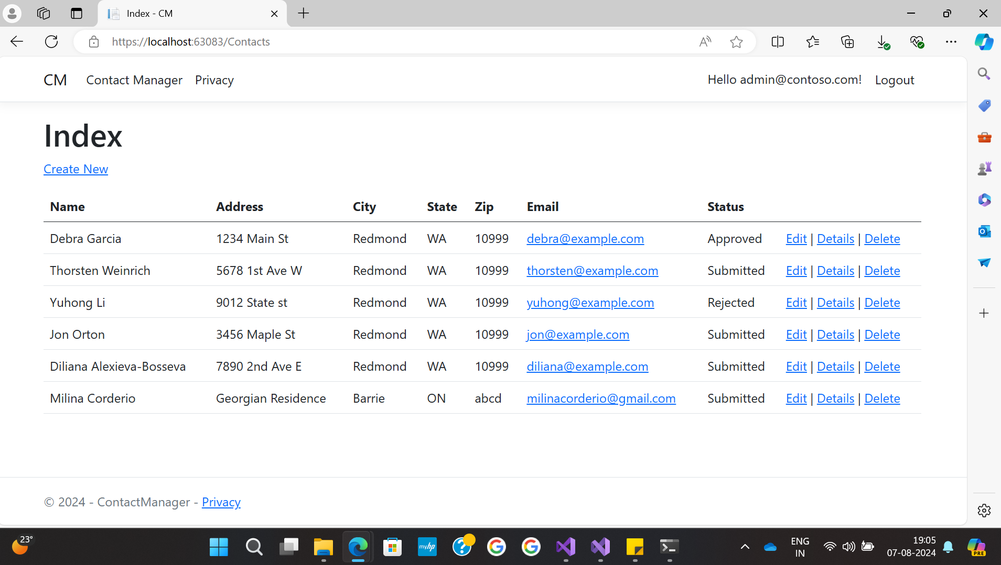
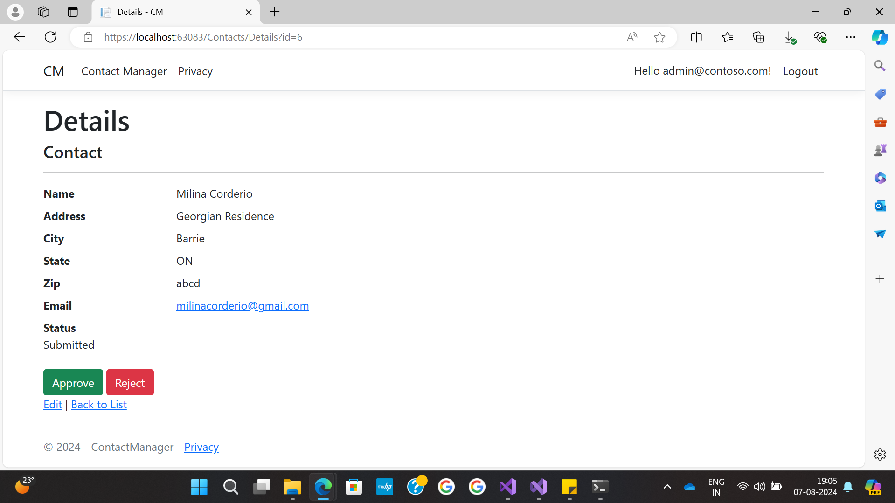
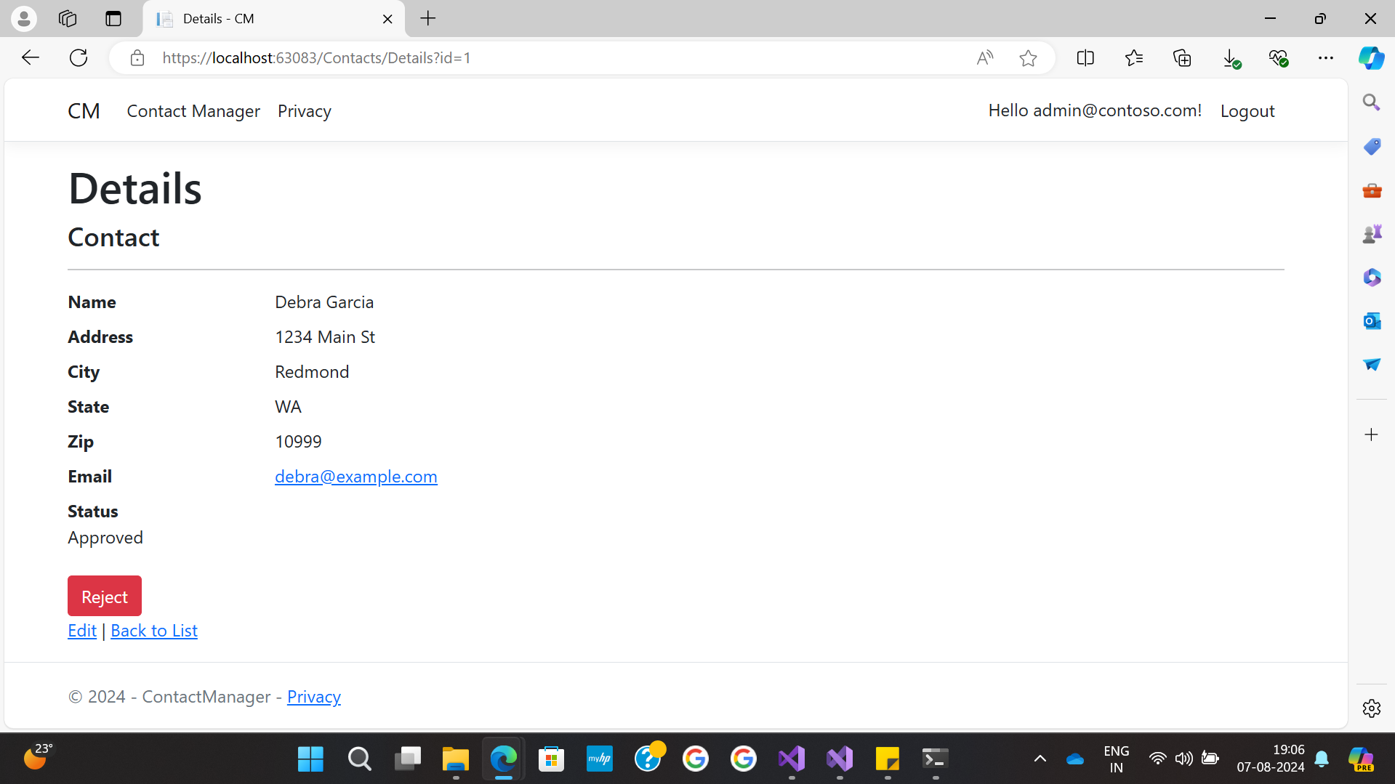
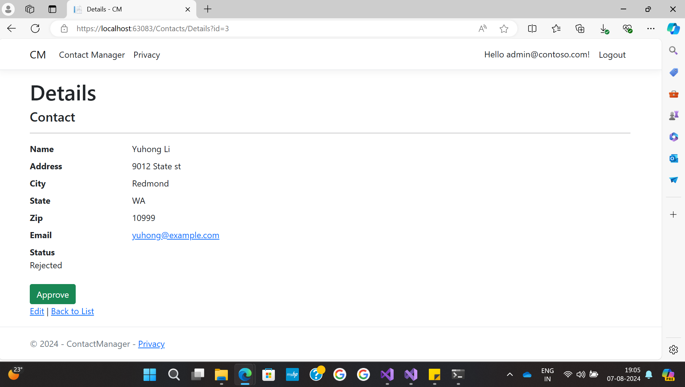
ADMIN VIEW

Slide 11
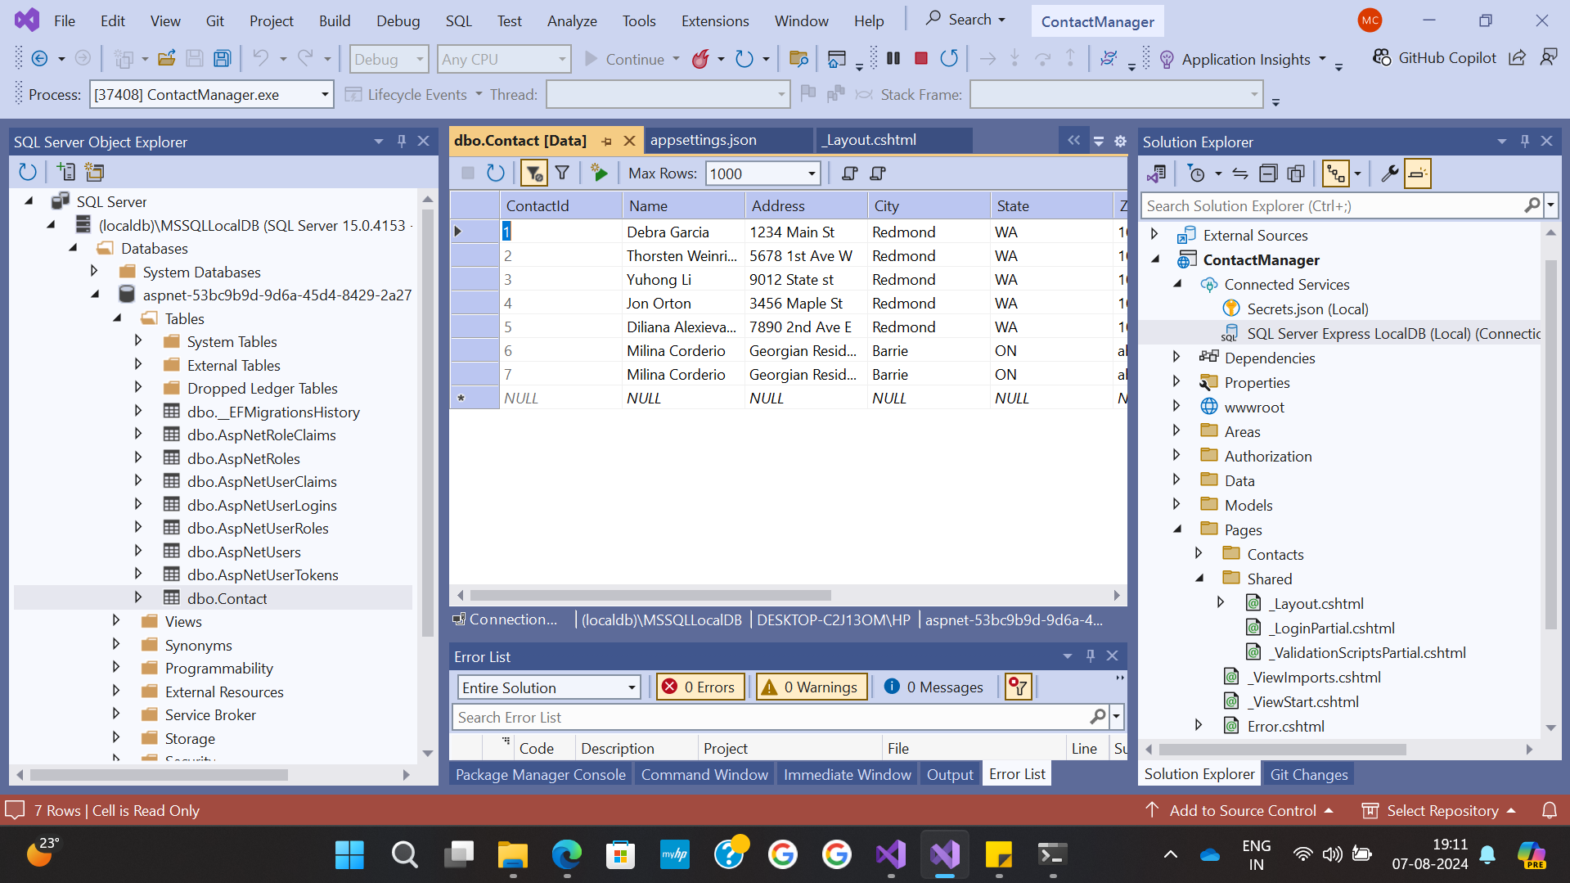
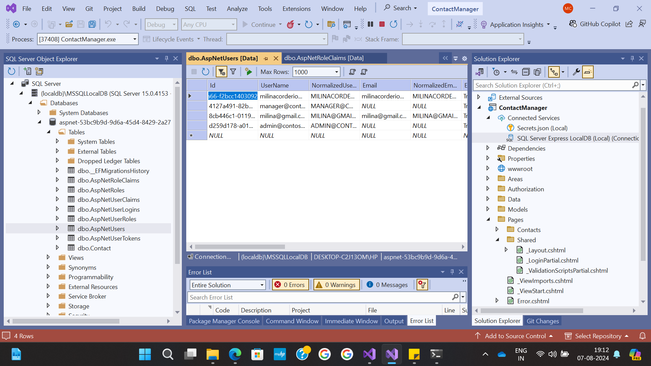
Data Management

Slide 12
Conclusion
This ASP.NET Core web application seamlessly integrates comprehensive error handling, user-friendly interfaces, and robust security measures. By utilizing a suite of technologies including SQL Server, ASP.NET, C#, HTML, and CSS, it ensures a scalable, efficient, and responsive platform. Future improvements will focus on enhancing security protocols, optimizing performance, and advancing data visualization capabilities, thereby providing a resilient foundation for continuous growth and innovation. Additionally, the application is designed to adapt to evolving user needs and industry standards, ensuring long-term sustainability and relevance.

